Slide 1
Final Project
John Williams
Data Visualization
DSCI 605

Slide 2
The Data
There are two main data files to be used for this proposal. They are ‘unemployment_county.csv’ and ‘crime_and_incarceration_by_state.csv’.
The main columns used by ‘crime_and_incarceration_by_state.csv’ are “jurisdiction” (chr), “year”(dbl), “state_population”(dbl), and “violent_crime_total”.
The reason these were selected is that you will need “jurisdiction” and “year” to join with the unemployment file. The other columns are used to calculate a crime ratio.
The file ‘unemployment_county.csv’ and its columns “State”(chr), “Year”(int) and “Unemployment Rate”(dbl) were selected.
With a groupby “State” and “Year”, the “Unemployment Rate” for a year is used to calculate a mean unemployment rate for each year per state.
Plotly is used to create the interactive graphs.

Slide 3
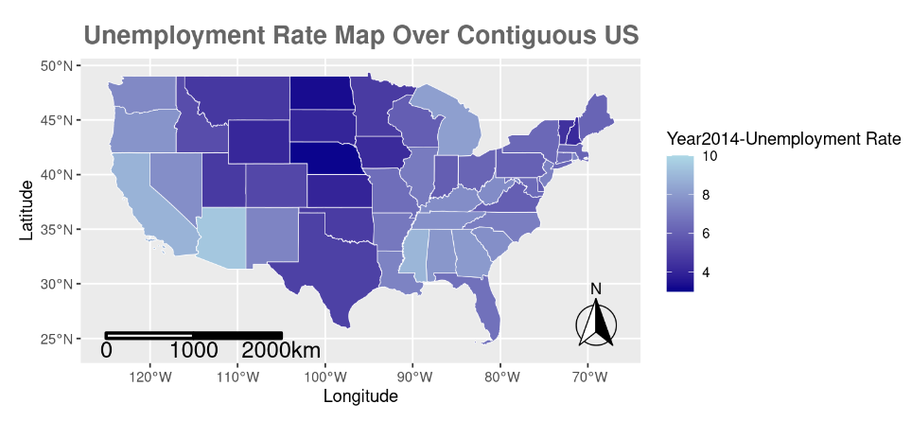
Unemployment Rate Map

Slide 4
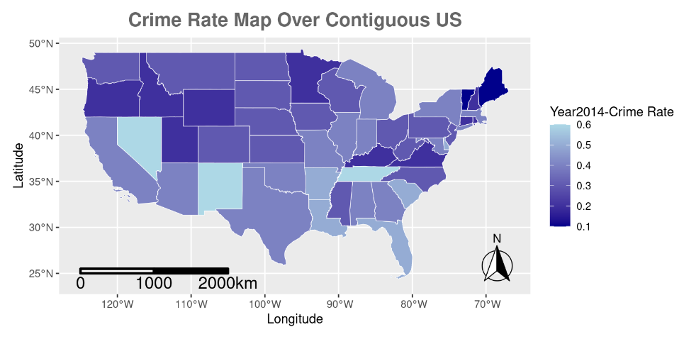
Crime Rate Map

Slide 5
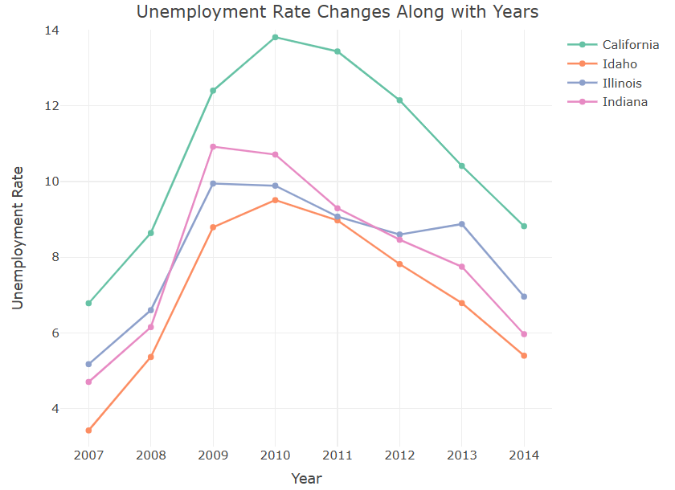
Interactive Unemployment Time Series

Slide 6
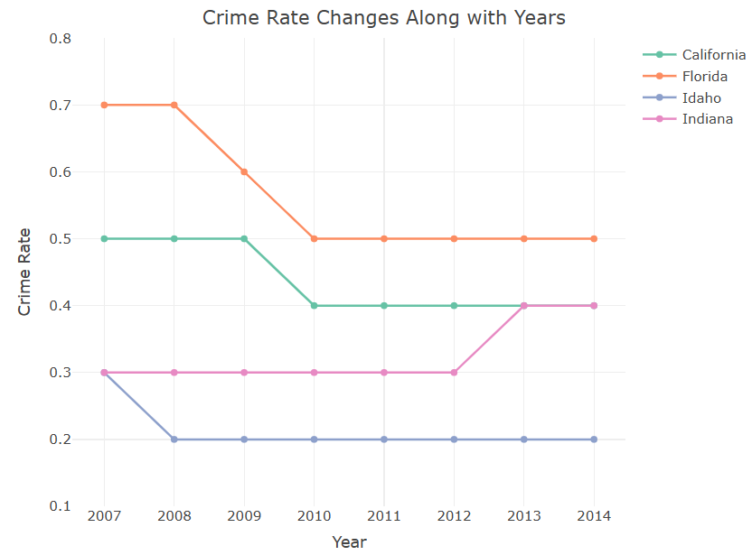
Interactive Crime Rate Time Series

Slide 7
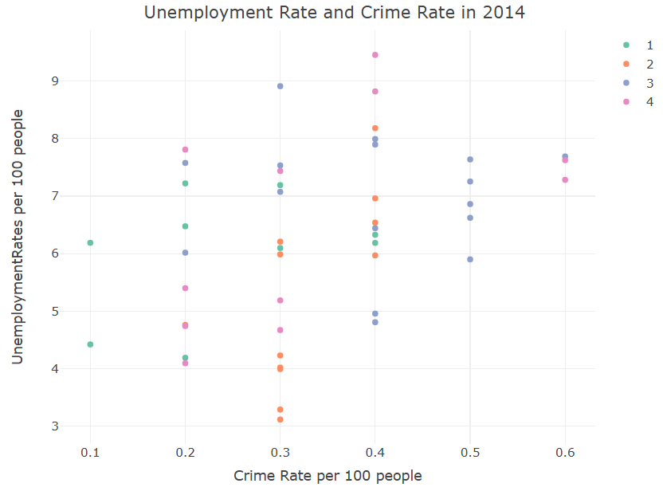
Interactive Scatter Plot

